Slide 1
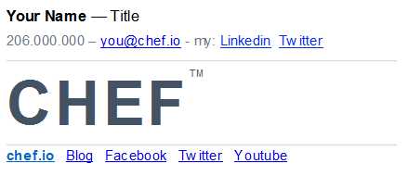
Creating Your Chef Email Signature
As a valued member of our Chef team, we’d like you to join us in using our standard email signature.
Key Features:
chef.io email address (you@chef.io)
Please do not use chef.com
Please do not use getchef.com
CHEF ™ logo with trademark symbol
Customizable social media links

Slide 2
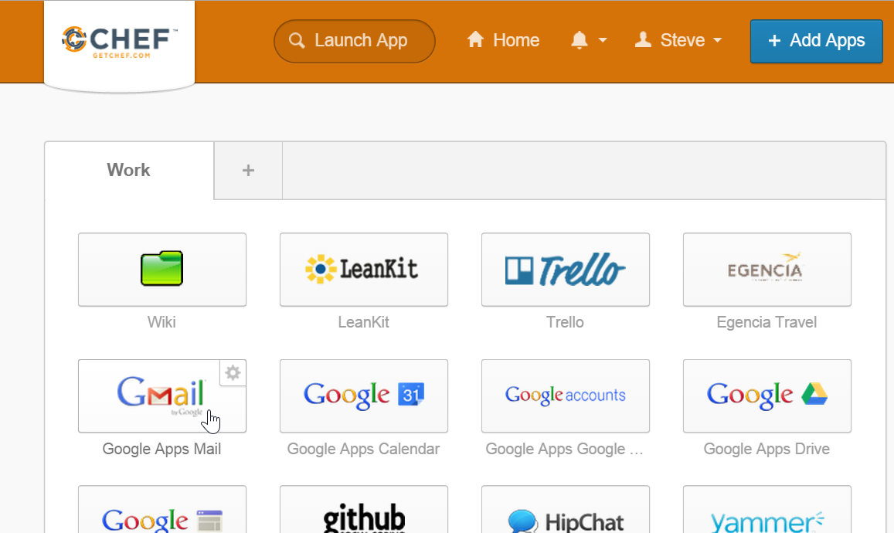
Creating Your Chef Email Signature
If you use our Gmail webmail service only, then you’ll only need to perform the Webmail steps in this presentation.
If you use an email client only, such as Outlook, then you’ll need to perform similar steps in your email client Mail settings.
If you use both, well, you guessed it, you’ll want to configure both systems.

Slide 3
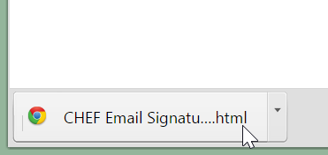
Creating Your Chef Email Signature - Gmail Webmail
Steps
Click this link: Chef Email Signature Download Link (This may take moment to download.)
The signature file should download to your laptop so click the file to open it. You may need to look in your Downloads folder if the file doesn’t appear at the bottom of your browser.

Slide 4
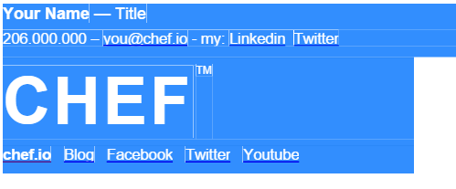
Creating Your Chef Email Signature - Gmail Webmail
Steps
From the resulting page, select all and copy the contents of the template.
Tip: You can use hot keys to select and copy the contents by using Ctrl a and then Ctrl c.

Slide 5
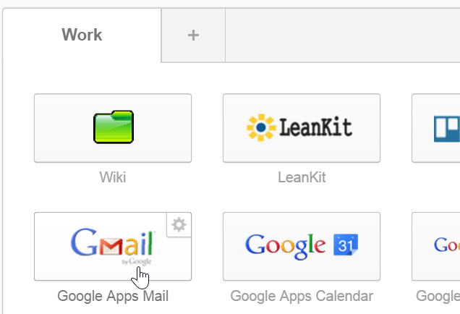
Creating Your Chef Email Signature - Gmail Webmail
Steps
Launch your Google Apps Mail if it’s not already open.

Slide 6
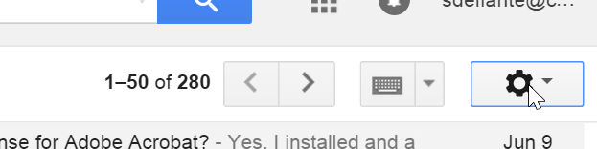
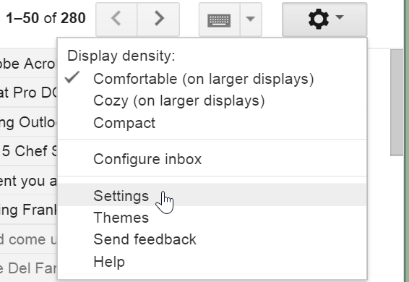
Creating Your Chef Email Signature - Gmail Webmail
Steps
From the top-right of your webmail page, click the Gear icon.
Click Settings.

Slide 7
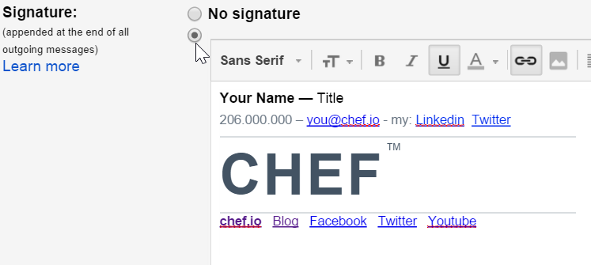
Creating Your Chef Email Signature - Gmail Webmail
Steps
Scroll down to the Signature section of the Settings page (under the General tab), and paste the contents that you copied in a previous step.
Note: Be sure to click the radio button that’s below the “No Signature” radio button.

Slide 8
Creating Your Chef Email Signature - Gmail Webmail
Steps
Customize the signature with your specific information by typing the following over the template text:
Your name
Your title
Your phone number

Slide 9
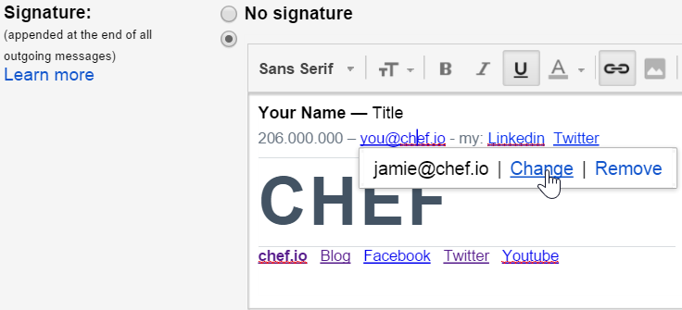
Creating Your Chef Email Signature - Gmail Webmail
Steps
Customize your email address by clicking the email address link and then clicking Change.

Slide 10
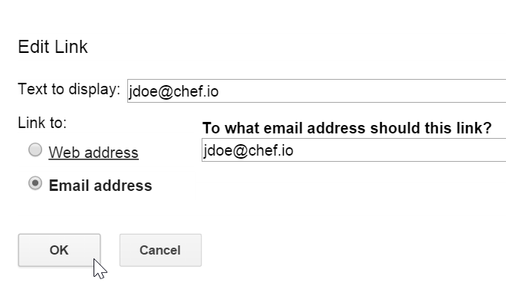
Creating Your Chef Email Signature - Gmail Webmail
Steps
Type your @chef.io email address in the two fields and then click OK.

Slide 11
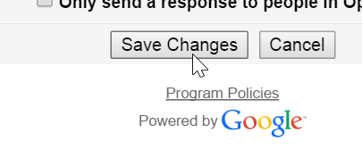
Creating Your Chef Email Signature - Gmail Webmail
Steps
At this point you could scroll down and click the Save Changes button and you’d be good to go if you use only Gmail webmail.
Note: You can customize your social media links if you like. We’ll show you how on the next slide.

Slide 12
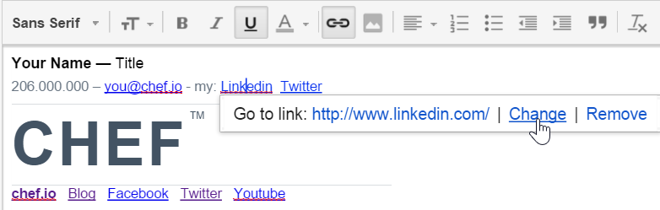
Creating Your Chef Email Signature - Gmail Webmail
Optional Steps
If you like, you can change the URLs for the Facebook and/or Twitter links to your own Facebook and/or Twitter URLs by clicking each of those links and then clicking the Change link.
If you don’t want to do that, just remove those links by backspacing over them.
Don’t forget to save!
You can change these
Not these please

Slide 13
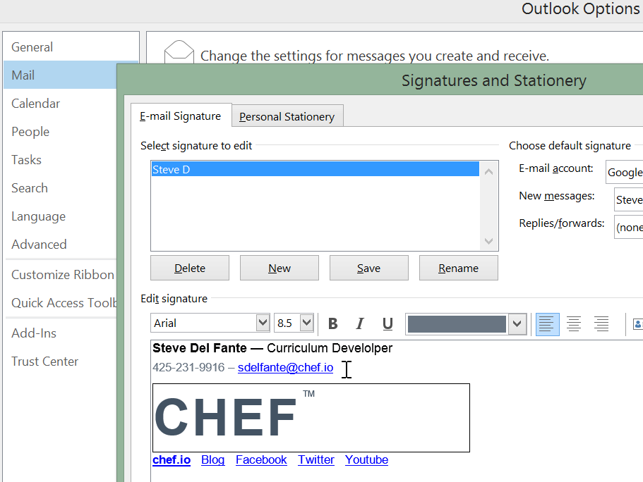
Creating Your Chef Email Signature - Email Client
You can also paste your customized signature into an email client such as Outlook.
The easiest way to do so is to copy your customized signature from your Gmail Settings page and paste it into your email client’s email settings Signature window.
For Outlook, click File > Options > Mail and then click the Signatures button to get the page shown here.

